Slide 1

Ltspice XVII
Modeling and Simulation
Outline and beginners' tips
Marc Chavez & Mark Hamann

Slide 2
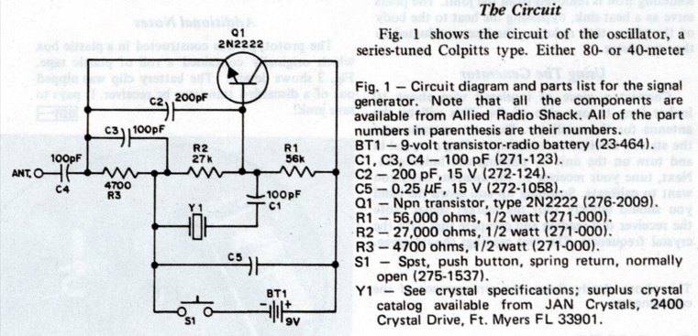
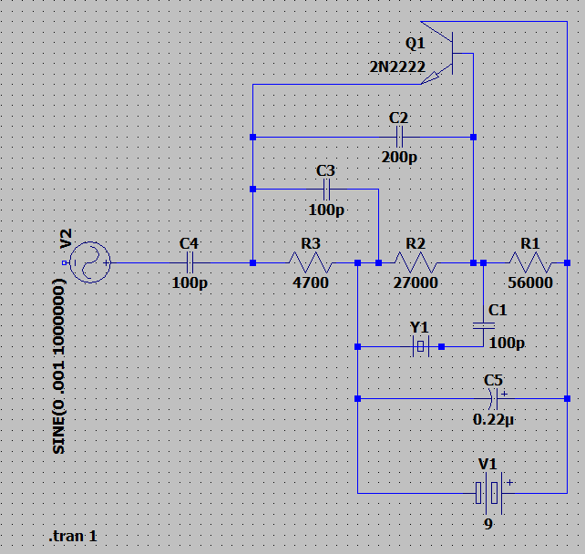
Startup
Download from: https://www.analog.com/en/design-center/design-tools-and-calculators/ltspice-simulator.html
Pick your OS
Install
Watch:
FesZ Electronics: https://youtu.be/JRcyHuyb1V0 or
EVVblog: https://youtu.be/FEGT5dUpdrc
Now is when the fun begins

Slide 3
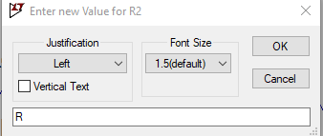
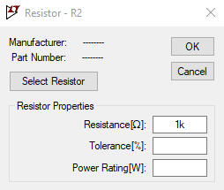
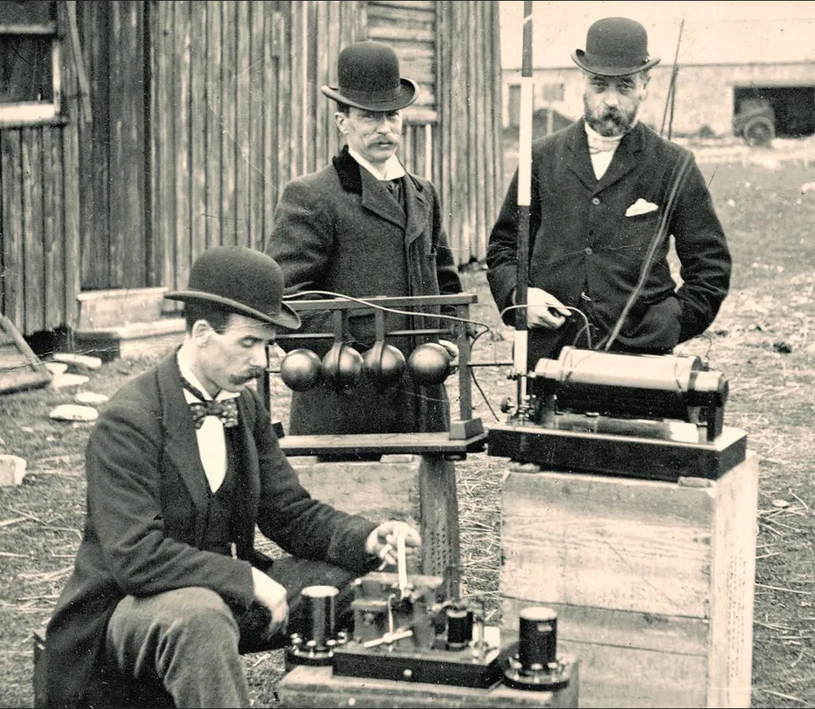
Things that mess you up:
Right click to stop placing extra stuff.
Left click to drag the view
scroll wheel to zoom (not a great zoom)
run wire thru component pgm will connect and trim.
Type in value and unit however, M (I meg Ω resistor) becomes 1m for milli. “meg” works.
Both dialog boxes below will allow change of value
Need to make the “run window” (.raw) active to activate probes etc
You may need to flip caps and resistors to get correct neg or pos voltage! (to rotate “move” and Cntl-R)

Slide 4
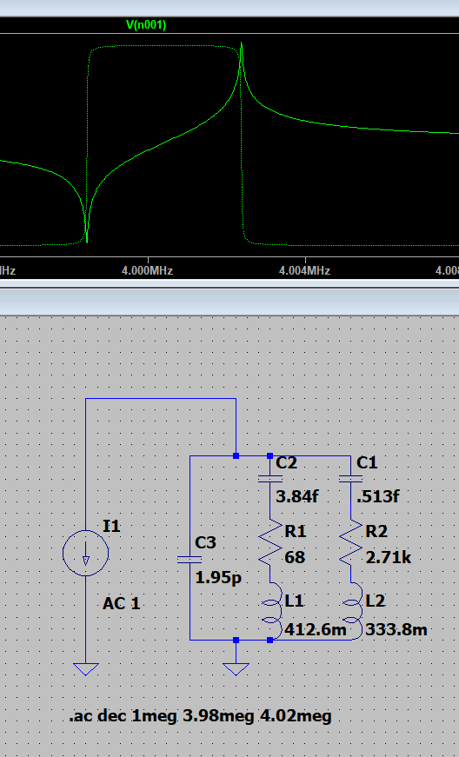

Simulate a crystal!
It worked!
Remember Ltspice is “Command Line Driven”
Much can be done with the GUI but you will need to pay attention to those little bits of text.

Slide 5
Places to go things to do! The google search just kept getting deeper and deeper.
Fesz YouTube episode on vacuum tubes https://youtu.be/7v9dG1uteAQ
http://www.normankoren.com/Audio/Tubemodspice_article.html
https://www.duncanamps.com/technical/ltspice.html
http://bordodynov.ltwiki.org/
https://gist.github.com/chanmix51/6947361
https://www.homecookingwithvalves.com/Triodescircuits-and-Simulations/Triode-Circuit-Simulation-with-Spice.html
https://sites.google.com/site/kensspice/vacuum-tube-related
https://funwithtubes.groups.io/g/main/topic/modelling_vacuum_tube/32109475
http://ayumi.cava.jp/audio/index.html
https://groups.io/g/LTspice/topic/introduction_of_a_new_vacuum/50257794
https://adrianimmler.simplesite.com/440956786

Slide 6
Radio and Ltspice
https://hackaday.com/2017/02/15/ltspice-for-radio-amateurs-and-others/
https://electronics.stackexchange.com/questions/637700/simulation-of-radio-in-ltspice
https://robs-blog.net/2017/02/10/lt-spice-for-radio-amateurs-part-1/
http://play.fallows.ca/wp/projects/electronics-projects/ltspice-ham-radio-simulation-great-learning-tool/

